Slide 1
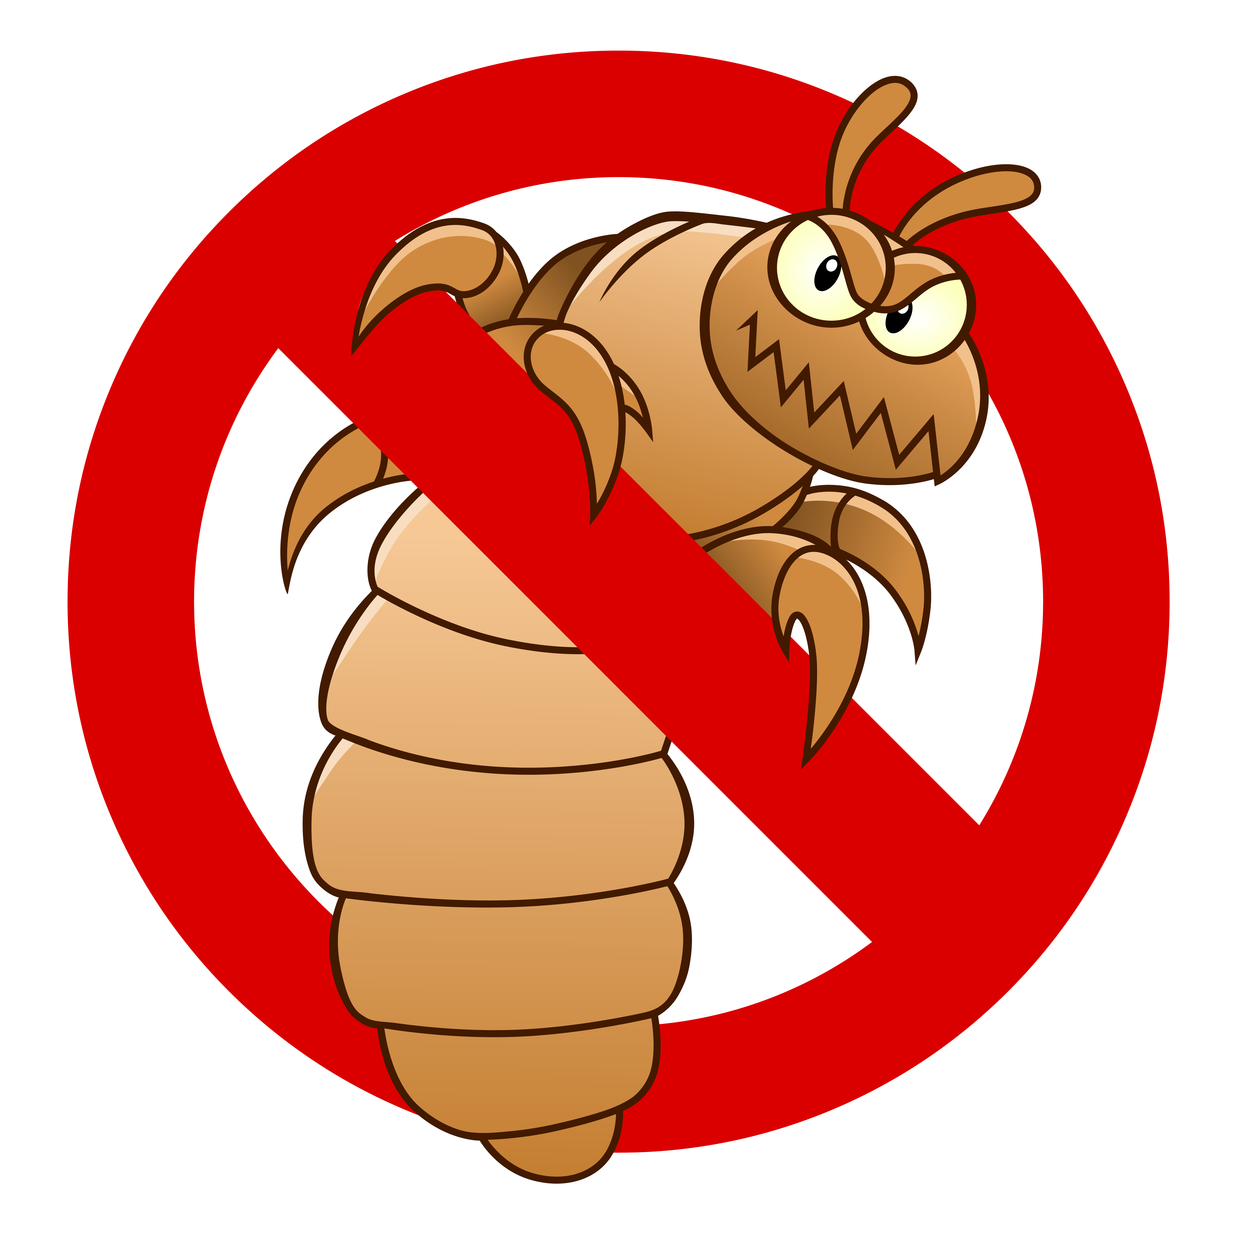
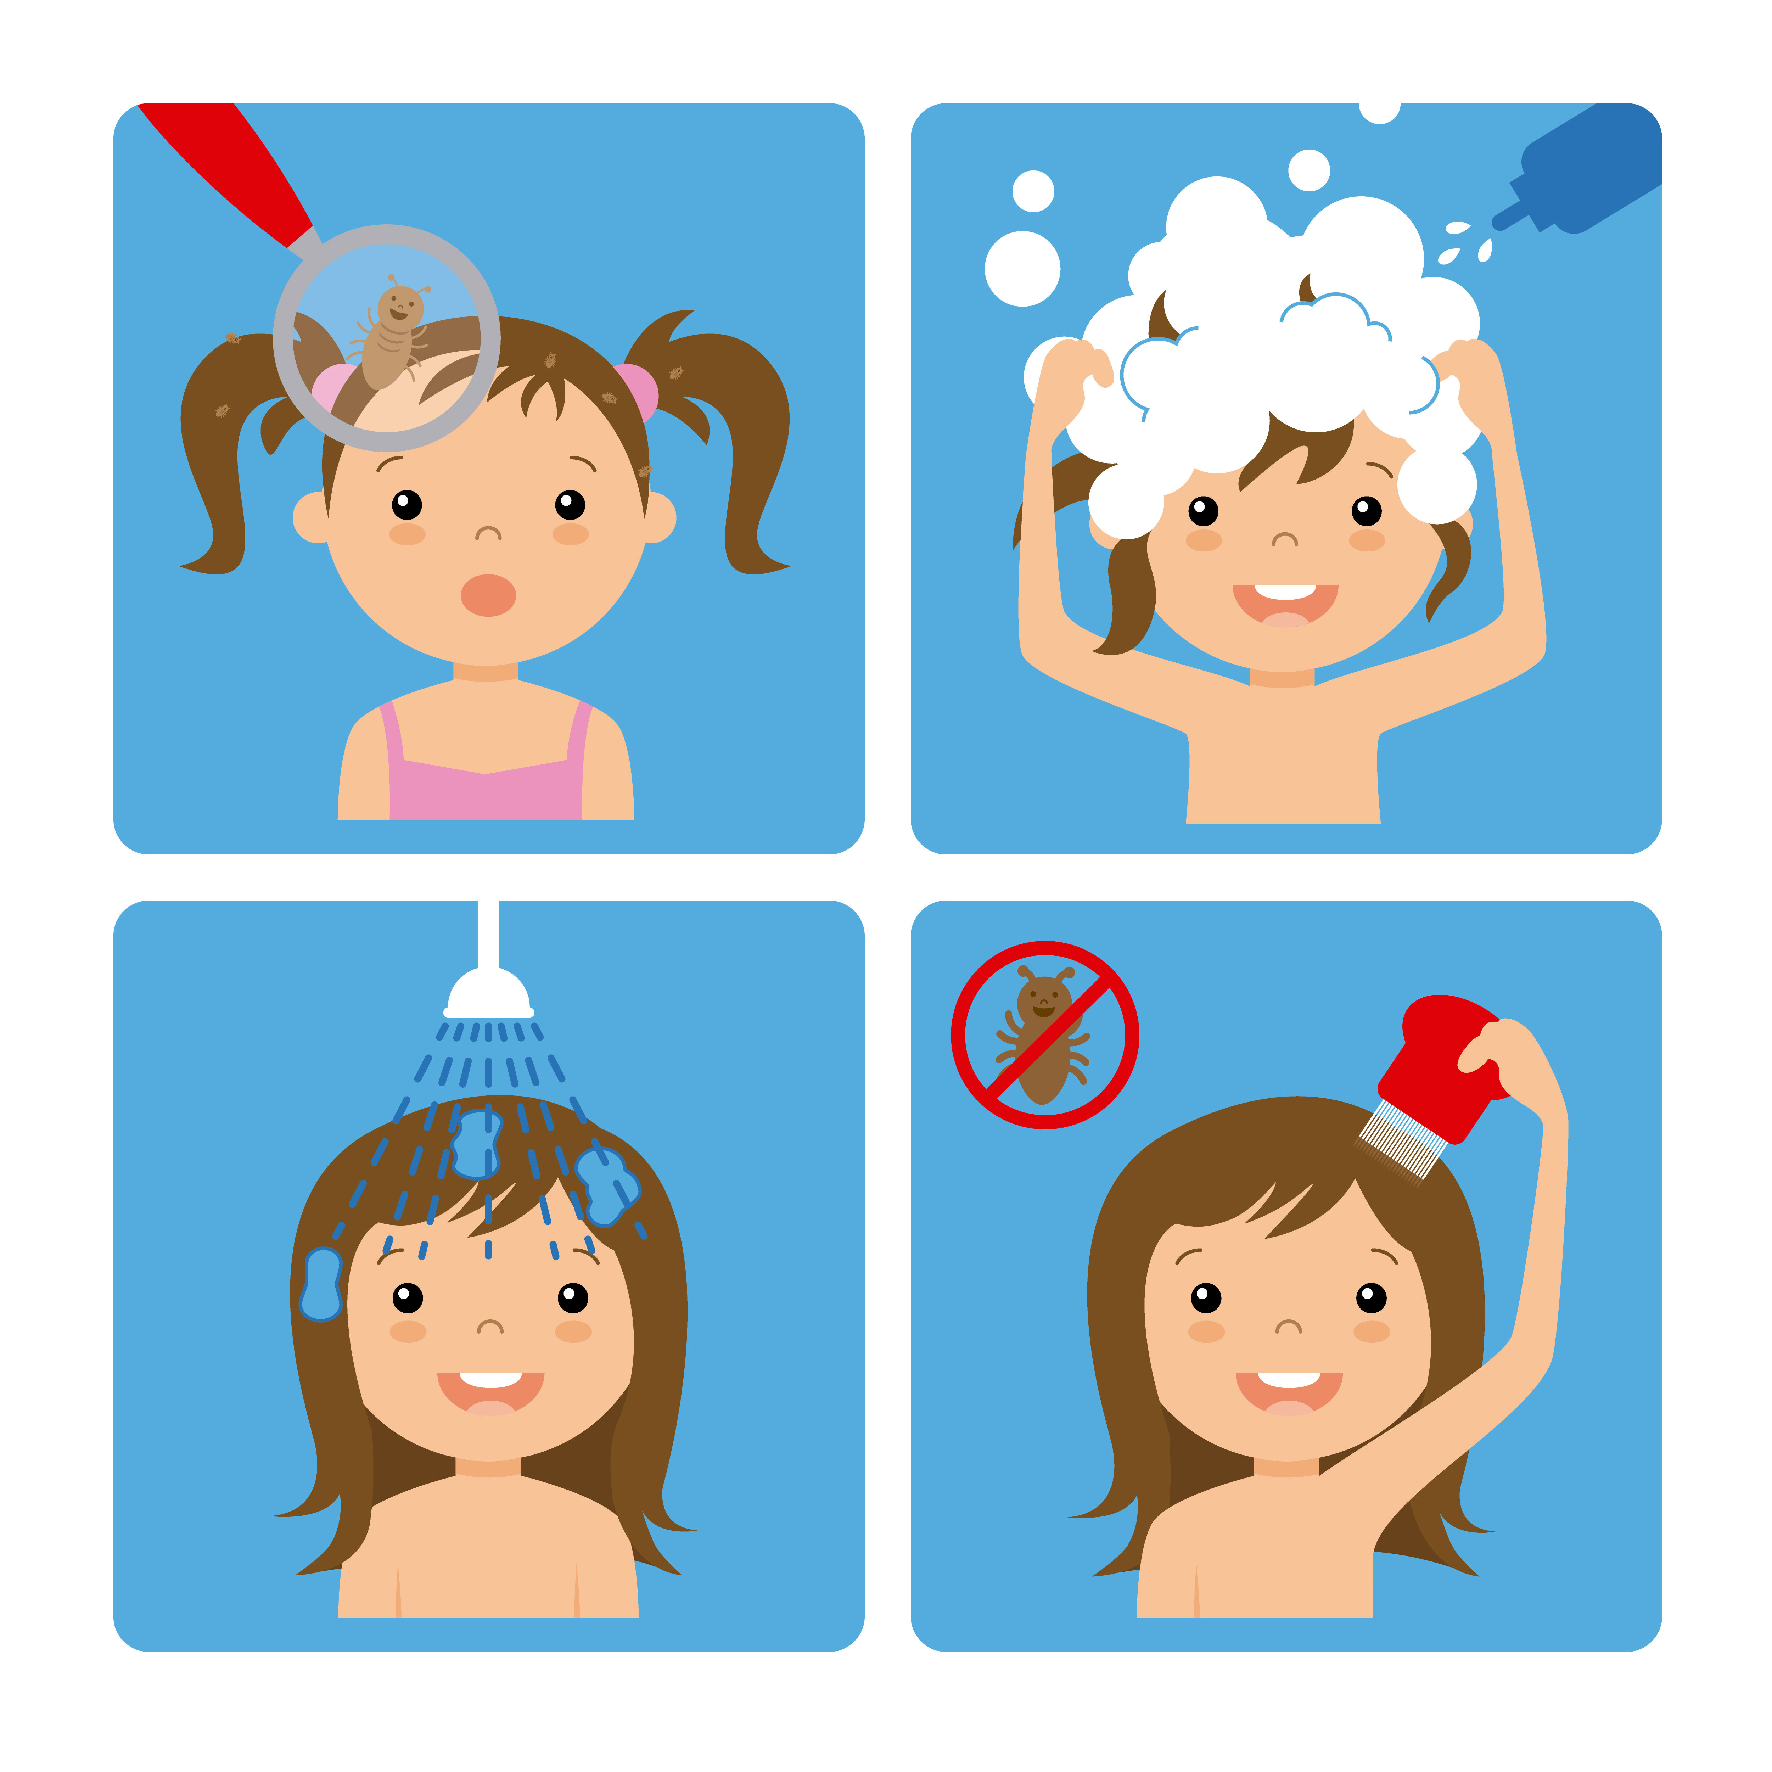
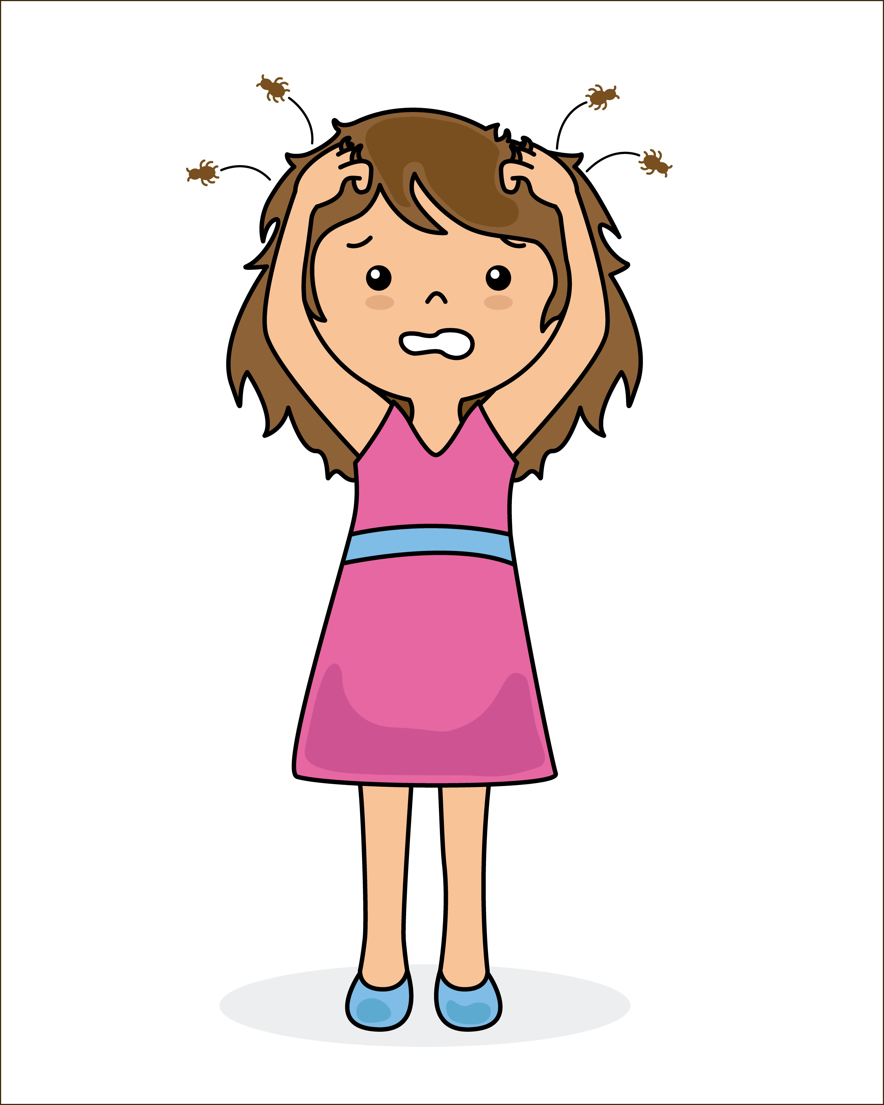
Treating Head Lice
It’s not always possible to prevent lice, but here are some tips for spotting them early!
Once a week take a peek! - Check your child’s head regularly with a fine-toothed detection comb
If you spot lice check the rest of the family and treat all infected heads at the same time
Avoid head-to-head contact and sharing brushes/combs with infected people
Treatment
The most effective way to treat lice:
Use a detection comb in wet, well-conditioned hair making sure you get all the hair, root to end! Repeat this every 3-4 days for 2 weeks to be certain all the lice have been caught
Medicated lotions/sprays are another option – make sure you follow instructions carefully and only use after a definite sighting of live lice!
Important to Remember!
Head lice are tiny brown insects, nits are brown or white eggs that lice lay in the hair
The most common age for kids to get them is between 4 and 11, so be vigilant with checking
Symptoms are not always present – don’t use this as an indicator of lice
If your child is persistently catching lice you should seek further advice from a health professional
Further Information and Advice available at:
Public Health England information on headlice is available at https://www.gov.uk/guidance/head-lice-pediculosis.
NHS information on headlice is available at http://www.nhs.uk/Conditions/Head-lice/Pages/Introduction.aspx

